Slide 1
Auditor Training on FSC^{(R)} CoC Core Labor Requirements (CLR)
MODULE 4.1
FSC Best Practice Guidance for Accreditation Requirements

Slide 2
Objectives of this Module
This module addresses the key and important FSC accreditation requirements governing FSC CoC CLR evaluation by CBs and their audit teams.
This module provides directives or guidance from FSC on how the CB shall implement the accreditation requirements.

Slide 3
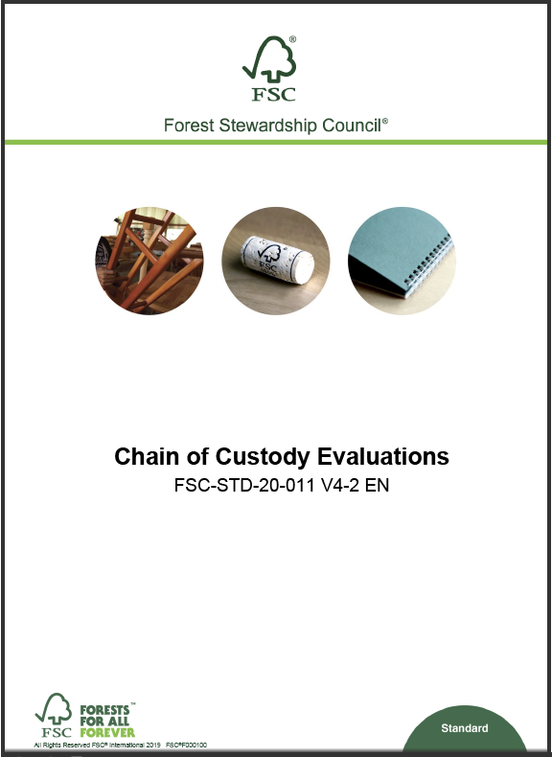
Key/Relevant FSC Accreditation Requirements for FSC CoC CLR?
The CBs are expected to comply with all applicable accreditation requirements during all their activities.
The following FSC Accreditation requirements are indispensable for ensuring a complete evaluation of the FSC CoC CLRs:
FSC-STD-20-011 v4.2 section 11 (Evaluation of FSC CLRs)
FSC-STD-20-011 v4.2 section 2 (Onsite evaluation especially 2.6)
FSC-STD-20-011 v4.2 section 12 (reporting)

Slide 4
Auditing CLRs – What FSC-STD-20-011 says...
Requirement
11.1 The certification body shall verify that the organization has adopted and implemented a policy statement, or statements, that encompass the FSC core labour requirements.
11.2 The certification body shall verify that the policy statements are made available to stakeholders.
Discussion
Q1. What are some of the ways in which the CH can make the policy available to stakeholders?
Q2. Must the Policy statement be one single document? What should the contents be?
Notes:
Emphasize the fact that policies could be many different documents and not necessarily an exact copy of the normative requirements, however all CLRs must be covered in the Policies.
Emphasize the fact that CAB must check if workers are aware.
Check if workers are aware of these policies (that is where implementation starts) through:
Training
Notice Boards
Websites
Meeting minutes
NOTE: Made Available On Request is not acceptable, as workers have to be aware of such policies in order to refer to them or ensure compliance.
A Policy must be in place
Could be many different documents
Must not be exact copy of the requirement text

Slide 5
Auditing CLRs – What FSC-STD-20-011 says..
Requirement | Includes
2.6 The certification body shall evaluate each operational site within the scope of the evaluation (including a sample of participating sites of group and multisite certificates and non-FSC-certified project members in the case of project certificates) in order to make direct, factual observations to verify the organization’s conformance to all applicable certification requirements. The evaluation shall include: | identification and assessment of management documentation and a sufficient variety and number of records at each operational site interviews with a sufficient variety and number of employees, their representatives, including worker’s organizations, employer’s representatives, and contractors, at each operational site selected for evaluation ... The interviewer shall ensure that comments can be provided in confidence; … ... … physical inspection of all sites selected for evaluation, including inspection of all locations where operational activities under the scope of the certificate are carried out.
Discussion
Q1. What are some of the elements you need to consider when deciding on your sample (sufficient variety and number)?
Notes:
This is one of the requirements where ASI has identified the most issues on COC audits and mostly around the highlighted keywords.
These keywords are discussed in next slide (Slide 6).
Keep in mind that Clause 2.6 of FSC-STD-20-011 V4-2 is specific to evaluation at the level of the operational site, this is not specific to RLF but general to CoC evaluations.

Slide 6
Auditing CLRs – Remember these keywords ...
Key words / phrases | Reminders
Policy statement, or statements | The CH commitments must be written/documented somewhere. That is why the requirement refers to "statement“. These may also be included in available procedures.
Made available to stakeholders | The affected stakeholders must know about the policies.
Verifying self-assessments | The Auditor does not only look to see if self-assessment is signed. You must evaluate its implementation in detail.
Corroborating evidence | This means you must triangulate and ensure that the evidence used is truthful and accurate by checking with other independent sources
Sufficient variety and number | There is no threshold for sufficiency, but the intent here is that the sample has to be representative (both in number and variety)
Interviews | Auditors must talk to the people and workers. Interview techniques are critical here; ensure these are conducted in confidence.
Physical inspection of all sites | Auditors must go to the actual operational sites (factory, sawmill, warehouse, etc.) to make direct factual observations and not just stay in office.
Notes:
These are definitions or clarifications on what is expected around each of these words.
These are keywords from the FSC-STD-20-011 accreditation requirements relevant to CLR evaluation.
This is a reminder for trainees.

Slide 7
EXERCISE
During an audit, you observe the following:
  In the self-assessment, the response to most of the requirements is “does not employ workers”, however in most sites/members visited during this audit, it was noticed that the members have employed workers (full time/part-time).
    Throughout the audit, only one (1) worker of a site of over 50 was interviewed, with no workers interviewed at the outsourcing facilities.
    No time records, or records of salaries or working hours, including overtime, were looked at during the audit. Also, no records on part-time workers were checked. The evaluation was limited to checking the employment contracts.
Discussion
Q1. What issues do you see regarding these observations?
Notes:
First, let the group read out the question and then you ask one or two participants for answers. Then go to next slide to provide suggested answers and discuss.

Slide 8
There is an NC:
The certification body audit team did not appropriately implement a system for evaluating the relevance, effectiveness, and adequacy of the organization’s self-assessment and conformity to Section 7 of FSC-STD-40-004.
WHY?
ANSWER
Insufficient interviews (1 out of 50 is not representative variety and number);
Documents were not checked to corroborate and evaluate implementation of requirements;
The self-assessment was not evaluated or not addressed.
Notes:
It is an NC against FSC-STD-20-011 v4.2 clause 2.6b) (did not interview sufficient workers and not evaluate sufficient samples to make factual observations)
or
clause 11.3 (did not implement a system for evaluating CLR relevance and effectiveness)

Slide 9
Auditing CLRs – What FSC-STD-20-011 says...
Reporting
12.1 The certification body shall document its evaluation findings and conclusions in a report according to the requirements specified in this standard, […]. Evaluation reports shall […] include at least the information specified in Table B below. Table B. Minimum content of evaluation reports Item 4 c) Systematic presentation of findings demonstrating conformity or nonconformity to each element of all applicable FSC normative document(s) used for the evaluation (e.g. FSC-STD-40-004, FSC-STD-40-005).
Discussion
Q1. What does “clear and systematic presentation of observations and findings” mean?
Q2. What are examples of objective evidence when it comes to CLR topics?
Notes:
Emphasize the presentation of objective evidence. For example, reporting evidence from interviews should also be clear even if anonymously presented. E.g. Interviews with workers in the shipping department….Interview with the union representative revealed that.,..
Regarding names, CAB’s system must contain information about who was interviewed even if anonymized in reports. Either there is a list in appendix which is not directly included in the report, but available in the CAB’s system upon request.
Documents reviewed, the reference must be cited (e.g. the payslip of worker ABC for month of July 2023 or Invoice # 9865 or Procedure XYD version 2).
The CAB reports MUST give information on how the CH complies with the requirement
CAB reports MUST provide the evidence that was used to evaluate compliance (document or interview or etc.)
OBJECTIVE EVIDENCE (traceable, tangible, verifiable).

Slide 10
EXERCISE
The audit report and checklist were checked to find that there were no worker interviews conducted and there was no translator despite the auditor not being able to speak the main language of the company (Greek).
Discussion
Q1. What issues do you see regarding these observations?
Notes:
First let the group read out the question, and then you ask one or two people for answers. Then go to next slide to provide suggested answers and discuss.

Slide 11
This is an NC.
WHY?
ANSWER
Compliance with the requirements was evaluated solely based on a documents/record review, which is deemed inadequate. There was no triangulation through interviews.
Worker interviews are a crucial aspect of ensuring conformance (implementation),
Policies may be good, but if not implemented, there is still a problem.
Without translation, the quality of interviews is compromised (interviewee not speaking in their most comfortable language)
Notes:
FSC-STD-20-011 V4-2, clauses 2.6 (onsite evaluation and interviews) or 11.3 (CAB’s guidance), or 12.1 (reporting).

Slide 12
End of Module 4.1
THANK YOU

