Slide 1
Auditor Training on FSC CoC Core Labor Requirements (CLR)
MODULE 3
Social Auditing Skills

Slide 2
This module provides guidance and best practices on social auditing in relation to auditing FSC CLRs.
The module covers 3 key sections:
3.1 – Audit Planning
3.2 – Objective Evidence and Triangulation
3.3 – Interview techniques

Slide 3
Module 3.1
Planning and Audit Preparation
Notes:
This will enable them to conduct audits that are comprehensive, efficient, and effective in driving positive change in organizations and supply chains.

Slide 4
Objectives of this Module
In this module, participants will learn how to
effectively prepare and plan for social audits by identifying potential risks related to certificate holders.
identify and prioritize risks, assess the credibility of information sources, and develop effective research strategies.
Notes:
This will enable them to conduct audits that are comprehensive, efficient, and effective in driving positive change in organizations and supply chains.

Slide 5
Audit Preparation
Desk Review
Elements to cover:
Identifying CH-related risks and previous issues Understanding relevant documents, such as CH Self-Assessment Understanding the company profile (number of employes, production facilities incl. Hazardous work etc.) Informing the audit team and the auditee of the audit activities Planning, scheduling and coordinating activities Improving the effectiveness of the audit process
The following information must be understood by the auditor before the audit
Key Information to be prepared with:
Knowledge of national law Previous Nonconformities and Reports Industry risks Country/region risk profile & map Workforce profile Known gaps & Human Rights violations Union presence and company´s stance
Notes:
Complete a document review before conducting each audit.
It is important to divide the team so as not to overload the auditors.
Planning the social audit is a particularly important step in defining the objectives, scope and criteria of the audit.
Good planning and time management are key to achieving effective audits, since the time available will always be too short for what you wish to cover during an audit.
Allocate sufficient time to address all questions prepared in advance
Representative sample: Gender mix and minority representation (immigrants, pregnant workers, workers with children, workers with physical disabilities, etc.).
Check dress code prior to the site visit, for practical reasons, to be ready to deal with management, and to help build empathy with workers during interviews.
You might check for desk review calculators, programs and videos.
Interviews discussed in details the next module.

Slide 6
Audit Preparation – continued
Documents to review before:
Self-Assessment Company Policies and Procedures Relevant Laws and legal requirements List of Documents & Permits Union Engagement and Collective Bargaining Agreement (CBA)s where they exist
Considerations for Interviews & Sampling:
Plan considering adequate audit time Think of the representativity of your selected sample Start planning your interviews Start thinking of what records you will need to see
Has the company provided a self-assessment for the FSC CLR?
Are there any results or missing information that calls your attention?
Notes:
Complete a desk review before conducting each audit.
It is important to divide the team so as not to overload the auditors.
Planning the social audit is a particularly important step in defining the objectives, scope and criteria of the audit.
Good planning and time management are key to achieving effective audits, since the time available will always be too short for what you wish to cover during an audit.
Allocate sufficient time to address all questions prepared in advance
Representative sample: Gender mix and minority representation (immigrants, pregnant workers, workers with children, workers with physical disabilities, etc.).
Check dress code prior to the site visit, for practical reasons, to be ready to deal with management, and to help build empathy with workers during interviews.
You might check for desk review calculators, programs and videos.
Interviews discussed in details the next module.

Slide 7
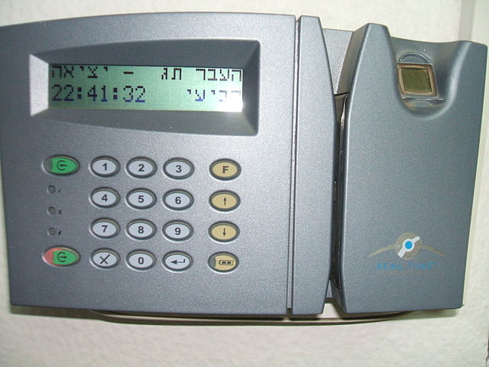
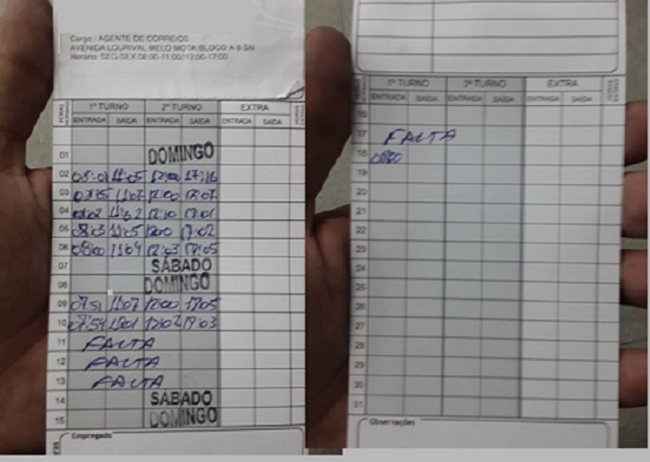
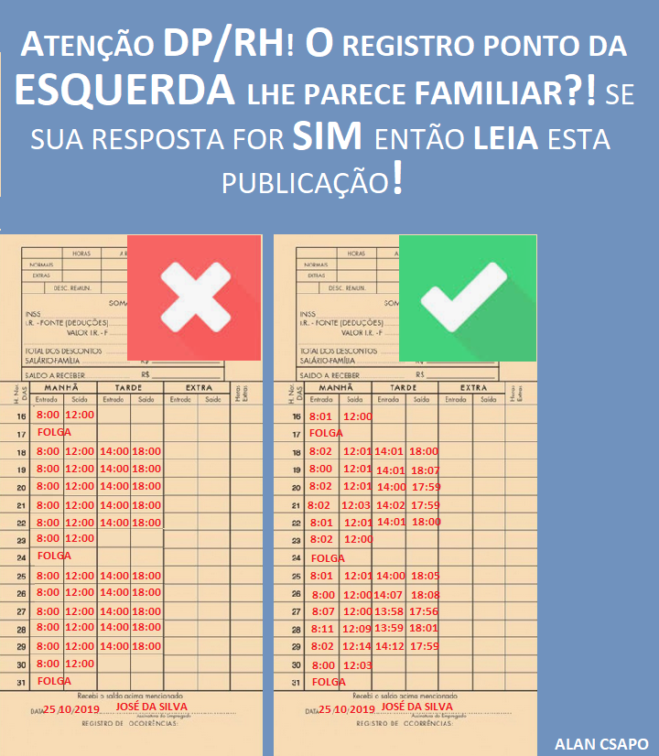
How prepared are you?
List of Documents & Permits
What documents state compliance with the law?
Does a Collective Bargaining Agreements (CBA) exist?
Do you know the key elements are?
Do you know and have you studied what the CH sent to you?
What would you like to see?
Tools needed when Verifying Records
Do you have prepared tools to investigate record your sample?
Age Calculator
MS Excel
Elements of CBA implementation
What are the relevant elements?
What records can be verified?
Notes:
Documents stating national and international applicable legislation
Age Calculator – Quick tool to calculate the exact age given the date of birth.
Example:
https://www.calculator.net/age-calculator.html?today=05%2F03%2F2006&ageat=05%2F03%2F2024&x=Calculate
MS Excel: Excel is a great tool to collect the entire staff information/payroll and quickly calculate ages and see if any worker is below minimum age. Also to compare employment date vs. age.
Ensure confidentiality in recording and authenticity and reliability of documents
ID documentation can be falsified - importance of triangulation.

Slide 8
Exercise
Q1.
What risks can you identify in this company?​
Q2.
Who would you need to consider for interviews?​
Q3.
What would you need to study beforehand?​
During an audit of the fictional CH "Super Bamboo Inc.", the following situation is observed:
The company has 90 workers in the production facility, 10 in office administration and sales.
30 workers at the production facility are nationals from a neighboring country.
The company operates in two shifts from 5:00 to 14:00 and from 14:00 to 23:00.
The company has an engagement with a local union and there is CBA signed.
There are two elected workers representatives at the company.
In the self-assessment, the company indicates that the signed CBA is four years old.
Notes:
Main risks:
Foreign workers : document retention? (forced labour) different treatment than national workers? (discrimination)
Overtime: Since two shifts. Are the required breaks/rest periods provided?
Implementation of the CBA: since only 2 elected representatives (auditor to clarify: is that sufficient by law? Is Collective Bargaining Agreement CBA up to date by law?)
Further risks could be: discrimination (e.g. difference in wages, languages spoken - management needs to make provisions to ensure requirements are understood by the affected stakeholders), recruitment fees (7.3.2 – withholding of wages....)
Need for Interviews:
Workers, HR department; Labour Union Representatives; Workers Representatives, local union as a key stakeholder with regard to CBA
Study beforehand: CBA; Legal requirements on Labour; Company HR procedures

Slide 9
Module 3.2
Objective evidence and triangulation

Slide 10
Objectives of this Module
This module focuses on the triangulation scheme for establishing findings in social audits.
Participants will learn how to use multiple sources of evidence to ensure accuracy and reliability in findings.

Slide 11
Objective Evidence
What is objective evidence?
Data supporting the existence or verity of something
A set of available facts or information that indicates whether a belief or proposition is true or valid.
ISO 19011:2018
?
?
?
Notes:
-Triangulation facilitates the validation or verification of evidence obtained from one source by cross-checking more than two sources.
- Three legs that provide the triangulation that will allow you to establish facts from objective evidence are: Observation, Listening and Investigation.
- Corroboration happens when two statements on the same subject from different sources closely match each other. Observation and document review can help to reduce the subjectivity of information gathered during interviews.

Slide 12
Triangulation
What is Triangulation?
the validation or verification of evidence obtained from one source by cross-checking more than two sources.
ISO 19011:2018
Observation
Interview
Document, Records and Information
Notes:
-Remember that almost everything you hear during an interview or observe during walkthroughs will be an opinion. You will need to corroborate it before it can be considered a fact to write in your audit report.

Slide 13
Classifying NCs
Before or during triangulation, you should consider the following when classifying findings:
Behavioral
Circumstantial
Structural
Notes:
Classify nature of NCs or Issues prior to triangulations.
Behavioral: Actions or conduct that goes against established norms. It involves individuals or groups not following expected patterns of behavior.
Circumstantial: Situations where a finding arises due to specific circumstances or temporary factors. It's not a consistent pattern but rather a response to a particular context.
Structural: Relates to non-conformity built into the system or structure itself. It means that the very design or organization of something doesn't align with established norms or regulations. It's not just about individual behavior but inherent in the way something is set up.

Slide 14
Exercise
During the interviews with workers at "Super Bamboo Inc." one group of workers report the following:​
​
“The management does not honor their word. They are not paying the production bonus that they have promised us, and they are frequently obligating us to work overtime. The foreign workers do not complain about it, but we, local workers don’t think this is fair!”​
Q1. Given these statements, what other information would you look at to triangulate this information from worker interviews?
Q2. Would you interview anyone else as part of this triangulation? Who?
Notes:
Other information: payslips (how are overtime hours recorded there, and are these paid at a higher rate than normal working hours? Is this rate in line with the legal requirements?), payroll documents, timesheet/logs;
Who else to interview: Finance department (whoever is in charge of salaries), Workers Representatives
Contracts should be reviewed with regard to the statement ‘obligating us to work overtime’: what does their contract terms say and is there mention of the ‘production bonus’?
Also review the grievance mechanism – are there complaints about this through the established channels to suggest this has been raised before to management? And is the worker representative aware of these concerns?

Slide 15
Exercise
During the site tour at "Super Bamboo Inc.", you speak with a worker who informed you that she is 13 years old.
Q1. Which FSC CLR is potentially not being conformed with?
Q2. How would you triangulate this information to confirm if there is a non-conformity??
Notes:
Potential NC: This is a potential child labour issue, please see Clauses 7.1 and 7.2 in FSC-STD-40-004-V3-1.
Triangulation:
Interviews to know what kind of work she does (hazardous, night shifts, dangerous, etc.)
Interviews with HR to know if she is intern or not? Is she going to school or not?
Review her contract (clarify when the worker started working there, check terms of work including role and working hours, check the worker register, check the policy on child labour, how does the company check date of birth of its workers)
Check if this is allowed by the national laws
Triangulate available information to determine if this a widespread potential issue at the CH or limited to this individual

Slide 16
Module 3.3
Interview Techniques

Slide 17
Objectives of this Module
This module covers the theory on conducting interviews related to social issues.
It will provide best practices and tips for conducting effective management and worker interviews, including how to ask open-ended questions, actively listen to responses, and build rapport with interviewees.

Slide 18



What is an interview?
An interview is a question-and-answer session designed to elicit information. (ISO 19011; A.17)
The interview differs from an ordinary conversation.
It is semi-structured — not free-form — and is designed for a purpose.
FSC-STD-20-011 v4.2 cl 2.6 c): as a minimum, interviews shall be conducted to verify training measures and understanding of individual responsibilities at different locations across the operation under evaluation;
See also FSC-STD-20-011v4.2 cl 11.3)
But note that all conversations during the audit are also sources of information.
Notes:
Important statement: The conversations throughout the audit are also important sources of information.
Auditors should be capable of having a conversation in a way that elicits information from the other person.
The auditor should be an active listener the entire time of the audit.
FSC-STD-20-011 V4-2, Clause 2.6:
b): interviews with a sufficient variety and number of employees, their representatives, including worker’s organizations, employer’s representatives, and contractors, at each operational site selected for evaluation in order to verify the organization’s conformance to all applicable certification requirements. The interviewer shall ensure that comments can be provided in confidence;
c) as a minimum, interviews shall be conducted to verify training measures and understanding of individual responsibilities at different locations across the operation under evaluation;
Furthermore, FSC-STD-20-011 V4-2, Clause 11.3c) clarifies that the CB shall evaluate the means of verification for (…) corroborating evidence provided by the organization with independent sources when possible. (e.g. documentation, interviews etc.) as required according to Section 2.6 ‘Evaluation at the level of the operational site’.

Slide 19
Discussions from Pre-reading material
Qualities of an effective interviewer
Q1. What are some of the traits and interpersonal skills of a good interviewer?
Q2. What additional skills are needed for conducting FSC CLR audits?
Notes:
The following are key aspects of competent interviewing
Strong interpersonal skills
Others are willing to share information with you
Do not interrupt with unnecessary questions
Enables people to share relevant information voluntarily
Displays honest interest in the person and subject
demonstrate fairness while attempting to obtain information
Effective interviewers work informally - not hard structured
Absence of bias
Project professionalism and excellence (attitude and appearance)
Represent no threat to the interviewee
Ensure confidentiality during and after the interview and audit

Slide 20
Discussions from Pre-reading material
Base Procedure for Interviews
Exercise: Provide two (2) important elements to consider at each of the following stages of an interview:
Planning
Preparation
Closure
Notes:
Plan:
Size of the population - Sample size (calculator)
Key people (union, worker representatives, key functions, whistleblower, ...)
Key demographics (groups, minorities, shifts, depts, gender, age, context specific issue)
Documents (list of workers, wage levels, policies,...)
Interview location
Audit plan (when do you plan the interviews, which subjects, what is the main objective)
Prepare:
Line of questions
What needs confirmation?
What can you share or not share of information?
What do you need to see beforehand?
What you need to know beforehand? (wage policy, accidents, conflicts, representative election, new CBA)
Engage & Explain
Account, Clarify and Challenge
What points do you need clarification?
Where is unclear?
Where do require confirmation? Closed Questions
Where do you cross check subjects among different interviews?
Apply the three Rs
Closure
Appreciation of time and effort
Important for the reputation of the process and workers perception
Important to summarize and define action
Allowing questions is also a way to listen to priority areas - maybe you have not asked to right questions
Evaluation
Habit of evaluate every interview and determine action
Evaluate the interview for you and the audit - Some interviews are not giving you much some others might be off
Adjust your approach and evaluate if you need to make changes.

Slide 21
Questioning
T.E.D.
Tell me..,
Explain to me…, Describe to me…
5Ws
Who, What, Which, When, Why, How
3
Closed Questions
Notes:
TED - To gather information through uninterrupted account…
5Ws - To probe for further information…
Closed Questions (these are questions that can be responded to with "yes" or "no") - To confirm positives and negatives...

Slide 22

Interview flow Best Practice
Introduction
Ice Breaker
Open ended question
(e.g. what do you do in your role as…)
Focus questions
Summary and confirmation
Closing
For consideration:
Using Group interviews vs 1-2-1
Evaluate your location…surrounding, etc.
Notes:
1-2-1 interviews are most suited when you need to confirm very specific or sensitive information where confidentiality if extremely important e.g. salary amounts, which you will later need to crosscheck in other documents such as contracts and payroll
Group interviews are suited to confirm information that you may have already come across in documents and need to triangulate to see its veracity and extent. E.g. training events. Here confidentiality is not too important and also you need confirmation from “masses”.

Slide 23
Exercise
During an audit, a group interview was held on the factory floor, close to the manager's office. Workers were told their answers were confidential, however not everyone spoke, and those who did, only provided ‘yes’ or ‘no’ to the auditor's questions.
Q1.
Describe what the problems with this approach are?
Q2. How could it be improved?
Notes:
Issues: Being close to the manager's door made workers uncomfortable, as they imagined that either the manager would hear what they said or would appear at any moment. Workers were not put at ease.
Improvement: Ensure that interviews are conducted in confidence, i.e. away from any manager and not close to manager's office or area (see clauses 2.6b and 11.3c in FSC-STD-20-011 V4-2). Workers should be interviewed in their own work
spaces. Ensure that no hierarchy is there. This may foster better interaction with interviewees, ensuring that responses go beyond mere "yes" or "no" statements.
Remember: Auditors always need to consider the most suitable interview approach, taking the specific situation into consideration: an auditor should normally start with open-ended questions to encourage detailed responses, then use
probing questions to clarify specifics, and finally employ closed questions to confirm facts and ensure accuracy. Further, group interviews are normally more suitable to find out issues which are common to the group, such as procedures, while individual interviews are more suited to identify specific issues, such as individual treatment, promotion or salaries.

Slide 24
End of Module 3
THANK YOU

