Slide 1
Auditor Training on FSC^{(R)} CoC Core Labor Requirements (CLR)
Pre-Course Preparatory Reading
Module 4: Evaluating FSC CLR

Slide 2
In Module 4, participants will learn key and important FSC accreditation and certification requirements governing FSC CoC CLR evaluation by CBs and their audit teams.
This module provides directions or guidance from FSC on how the CB shall evaluate FSC CLR, as well as expectations from ASI regarding evidence of conformance.

Slide 3
This pre-reading material contains essential elements on how a CB conforms with accreditation requirements and how to evaluate each CLR, indicating who to talk to and what documents to review.

Slide 4
Module 4.1
Guidance for Accreditation Requirements

Slide 5
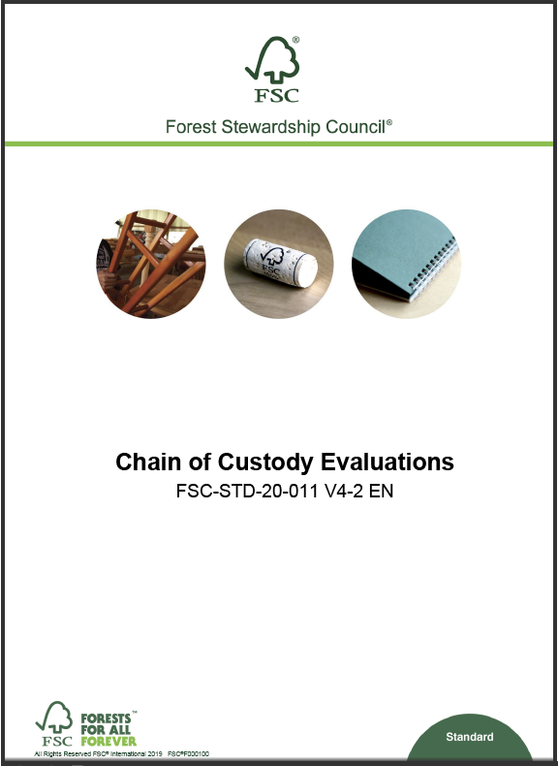
Key/Relevant FSC Accreditation Requirements for FSC CoC CLR
CBs are expected to conform with all applicable accreditation requirements during all their activities.
These are the main FSC accreditation requirements that are relevant for the evaluation of the FSC CoC CLRs:
FSC-STD-20-011 V4-2, Section 11 (Evaluation of FSC CLRs)
FSC-STD-20-011 V4-2, Section 2 (Onsite evaluation, especially clause 2.6)
FSC-STD-20-011 V4-2, Section 12 (Reporting)

Slide 6
Auditing CLRs – What FSC-STD-20-011 says
Requirement | What does it mean? | FSC Guidance / Best Practice
11.1 The certification body shall verify that the organization has adopted and implemented a policy statement, or statements, that encompass the FSC core labour requirements. | The CH must have incorporated the CLRs in its policy statements. | Check various policies. A Policy must be in place Could be many different documents Must not be exact copy of the requirement text
11.2 The certification body shall verify that the policy statements are made available to stakeholders. | They must be available to those concerned, especially WORKERs as they are the affected stakeholders | Check if workers are aware of these policies (that is where implementation starts) Training Notice Boards Websites Meeting minutes NB: Made Available On Request is not acceptable, as workers have to be aware of such policies in order to refer to them or ensure conformance

Slide 7
Auditing CLRs – What FSC-STD-20-011 says..
Requirement | What does it include? | FSC Guidance
11.3 The certification body shall design and implement a system for evaluating the relevance, effectiveness, and adequacy of the organization’s self-assessment and conformity to Section 7 of FSC-STD-40-004, according to the scope, scale, intensity and risk of the organization's operation. | The certification body shall specify, justify and document in its system the means of verification of the self-assessments, including, but not limited to: a) a mechanism for verifying self-assessments against available sources of information and applicable requirements; b) identifying the legal requirements related to the FSC CLRs and applicable to the organization/site. c) corroborating evidence provided by the organization with inendent sources when possible. (e.g. documentation, interviews etc.) as required according to Section 2.6 ‘Evaluation at the level of the operational site’. d) determining the frequency and sampling requirements of future audits within the certification cycle for each organization based on the results of the previous audit related to the FSC CLRs and the self-assessment. e) including auditors with specific competencies if needed. | The CB has to develop such a guidance in their “Auditor Handbook” and auditors are to follow it.

Slide 8
Auditing CLRs – What FSC-STD-20-011 says..
Requirement | Key aspects | What to do?
Evaluation at the level of the operational site 2.6 The certification body shall evaluate each operational site within the scope of the evaluation (including a sample of participating sites of group and multisite certificates and non-FSC-certified project members in the case of project certificates) in order to make direct, factual observations to verify the organization’s conformance to all applicable certification requirements. The evaluation shall include: (…) | identification and assessment of management documentation and a sufficient variety and number of records at each operational site interviews with a sufficient variety and number of employees, their representatives, including worker’s organizations, employer’s representatives, and contractors, at each operational site selected for evaluation ... The interviewer shall ensure that comments can be provided in confidence; … ... … physical inspection of all sites selected for evaluation, including inspection of all locations where operational activities under the scope of the certificate are carried out. | This is one of the requirements where ASI has identified the most issues on COC audits and mostly around the highlighted keywords.

Slide 9
Auditing CLRs – What FSC-STD-20-011 says..
Requirement | What does it mean? | FSC Guidance/Best Practice
12.1 The certification body shall document its evaluation findings and conclusions in a report according to the requirements specified in this standard, ... Evaluation reports shall …. include at least the information specified in Table B below. Table B. Minimum content of evaluation reports Item 4 c) Systematic presentation of findings demonstrating conformity or nonconformity to each element of all applicable FSC normative document(s) used for the evaluation (e.g. FSC-STD-40-004, FSC-STD-40-005). | Reports must have clear and systematic presentation of observations and findings of how the CH conforms with each requirement – that includes the CLR requirements. | The CAB reports must give information on how the CH complies with the requirement CAB reports must provide the evidence that was used to evaluate compliance (document or interview or etc.) Objective evidence (traceable, tangible, verifiable).

Slide 10
Module 4.2
Guidance for Certification Requirements

Slide 11
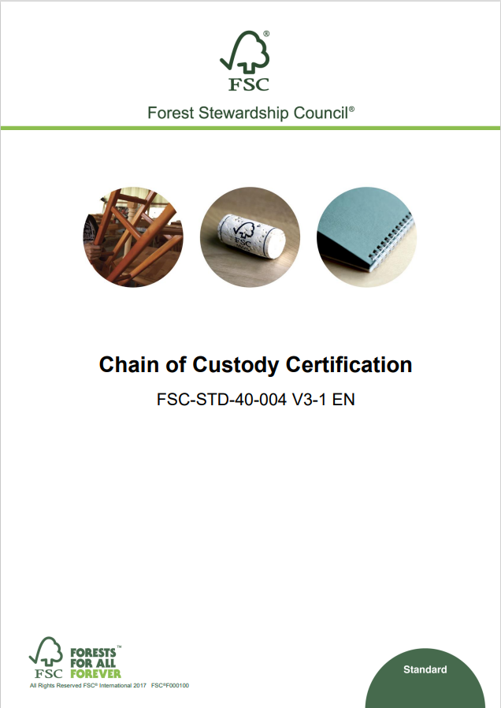
Key/relevant FSC CoC CLR Requirements
CBs are expected to audit against all up to date certification requirements applicable to the scope of the organization being audited.
However, the following requirements are indispensable for ensuring a complete evaluation of the FSC CoC CLRs:
  FSC-STD-40-004 V3-1, Section 1
  FSC-STD-40-004 V3-1, Section 7
  FSC-STD-40-004 V3-1, Annex D
  FSC-DIR-40-004 - ADVICE-40-004-23
  FSC-DIR-40-004 - ADVICE-40-004-24

Slide 12
Auditing FSC CLRs – Best Practice Guidance
Management system, Training and Awareness on FSC CLR FSC-STD- 40-004 v3.1 clause 1.1 and 1.4 | Key Elements | Why?
 | Management system / Procedures | CH COC procedures must incorporate requirements for FSC CLR implementation.
 | Training | Staff should be aware of procedures and policies. Those responsible for FSC CLR should be aware of the requirements and policies
 | Records | Records showing conformance with FSC CLR must be available
What to look for and where | Who to Talk to | Dos and Don’ts
Policies Company Manuals Interviews with staff and responsible persons | COC Representative HR department Legal department Workers | Be aware of the relevant requirements (but not necessarily everything)

Slide 13
Auditing FSC CLRs – Best Practice Guidance
Policy Statement (s) FSC-STD- 40-004 V3-1, Clauses 1.5 and 1.6 | Key Elements | Why?
 | Policy Statement | Must be Written and must refer to or contain ALL 4 FSC CLR topics
 | Implementation | The statements are binding and must be implemented.
 | Availability to stakeholders | Those affected (e.g. workers) must be aware of the policies - LANGUAGE
 | Self-assessment | CH evaluates themselves on how they meet the FSC CLRs
What to look for and where | Who to Talk to | Dos and Don’ts
Policy statement(s) (could be included in procedures). | COC Representative | Policy statement(s): There could be multiple and must not be the standard requirements written out Verbatim. Self Assessment: Use template provided by FSC and must be filled-in and signed by CH.
Policy could be in Manuals | HR department
Made available e.g., on Notice Boards, websites, in training material(s) | Legal department
Self-declaration | Workers

Slide 14
Auditing FSC CLRs – Best Practice Guidance
FSC CLR Self-Assessment FSC-STD- 40-004 V3-1, Annex D | Key elements
 | For Multi-sites or Groups, self-assessment can be centralized.
 | Annex D is normative and therefore the CB can raise an NC against its contents.
 | Self-Assessment must be up to date and be filled and signed by CH.
 | Self-Assessment is using template provided by FSC. Could also use own style but contents must be FSC’s
What to look for and where | Who to Talk to | Dos and Don’ts
Policies and Manuals Self Assessment | COC Representative | Do verify / evaluate implementation of the aspects indicated in the Self-Assessment

Slide 15
Auditing FSC CLRs – Best Practice Guidance
National Laws FSC-STD- 40-004 V3-1, Clause 7.1 | Key Elements | Why?
 | National Laws | ILO Conventions are normally part of Legal Framework.
 | Ratification of ILO Conventions | Not all countries have ratified (agreed to follow) all ILO conventions, so careful consideration is needed.
 | Awareness / Training | Ensure that CH knows the laws and follow these.
 | FSC CLRs | All FSC CLRs have legal requirements behind them.
What to look for and where | Who to Talk to | Dos and Don’ts
Applicable to all of section 7 and all FSC CLRs. There will be some aspects that do not clearly fit into any of the FSC CLRs but still represent a violation of Workers’ rights e.g. non-payment of required worker’s social insurance to government. | HR department Legal department (if any) Payroll department Employees Interns | Do consult Annex D and always refer back to legal requirements. Don’t only focus on standard clauses. They both go together.
Notes:
Term ratification: ratification refers to the formal approval of an ILO convention by a member state. When a country ratifies an ILO convention, it legally commits to implementing its provisions and aligning its national laws and policies with the convention’s standards.

Slide 16
Auditing FSC CLRs – Best Practice Guidance
Child Labour ILO C138 and C182 FSC-STD- 40-004 V3-1, Clause 7.2 | Key Elements | Why?
 | Minimum Age | No employment below 15 years (permitted in certain cases as per FSC standard).
 | Hazardous Tasks | No dangerous work for anyone below 18 years (non-adults).
 | National Laws and Regulations | Ensure that CH knows the laws and follows these
 | Worst Forms of Child Labour | Prohibited. See definition in Annex E.
What to look for and where | Who to Talk to | Dos and Don’ts
Workers ID documents Employment contracts Policies Employee registers/directory/ Payroll | HR department Legal department (if any) Payroll department Employees Interns | Do not limit discussions to Certification team. Do check workers IDs on file. Don’t only look at faces

Slide 17
Auditing FSC CLRs – Best Practice Guidance
Forced or Compulsory Labour (FCL) ILO C029 and C105 FSC-STD- 40-004 V3-1, Clause 7.3 | Key Elements | Why?
 | Overtime | Overtime is voluntary and correctly compensated.
 | Debts and credit facilities to Workers | Existence flags potential debt bondage.
 | Contracts contents | FCL is sometimes contractual; check for wording for consent and voluntariness.
 | Document Retention | Workers must be free to move (and leave) and have their documents with them.
What to look for and where | Who to Talk to | Dos and Don’ts
Policy statements Employment Contracts Payslips / Payroll (Daily) Work Attendance registers Salary softwares Leave / Resign or Dismissal records Grievance records | HR department Employees Employee Representatives Worker’s Union (Representatives) Legal department | Do not limit discussions to the Certification team. Read the Employment contracts in detail (sample). Review the calculation of overtime payments

Slide 18
Auditing FSC CLRs – Best Practice Guidance
Discrimination (DIS) ILO C111 and C100 FSC-STD- 40-004 V3-1, Clause 7.4 | Key Elements | Why?
 | Legal Discrimination | Countries often have rules on discrimination in law.
 | Gender and Diversity | Gender discrimination is the most common form.
 | Equality | Check if there is fair treatment and equal opportunities for all workers.
 | Others (age, handicap, sexual orientation, religion, etc.) | Check for unjust/unfair disparities in the workplace
What to look for and where | Who to Talk to | Dos and Don’ts
Policies Diversity in workers Employee registers/directory/ Payroll CH Vacancy/Job ads Compare payslips of workers in same positions Promotions and Recruitments Grievance records | HR department Legal department Payroll department Top Management Employees | Do not limit discussions to the Certification team. Watch out for things like access to training, promotion, compensation.

Slide 19
Auditing FSC CLRs – Best Practice Guidance
Freedom of Association and Collective Bargaining (FOA & CB) ILO C098 FSC-STD- 40-004 V3-1, Clause 7.5 | Key Elements | Why?
 | Trade Unions | Legal platforms to collectively represent workers
 | Collective Bargaining Agreements | Outcome of voluntary negotiations.
 | Workers Representations | Any instances where workers can discuss issues with Management.
 | Internal Complaints mechanism | Indicates workers’ freedom to raise issues (grievances).
 | Strike(s) | A means of workers’ exercising their rights.
What to look for and where | Who to Talk to | Dos and Don'ts
Policies CBA (Collective Bargaining Agreements) ToRs / Duties of Workers Reps Trade Union ToRs or meeting notes Worker’s Representatives reports Communications between management and Workers Complaints records News articles about strikes Suggestion Boxes Grievance records | HR department Legal department Workers Representatives Trade Union Representatives | Do: check how these are recorded triangulate information Don’t assume the existence of a committee means it is effective

Slide 20
Auditing FSC CLRs – Best Practice Guidance
Evaluation of FSC CLR of Contractors FSC-ADV-40-004-23 FSC-STD- 40-004 V3-1, Clauses 1.6, and Section 13 | Key Elements | Why?
 | Outsourcing | Section 13 provides general requirements for outsourcing agreements.
 | Certification Scope | Activities shall be within the COC certification scope
 | Sampling | FSC-STD-20-011 V4-2, Clauses 9.5 and 9.6.
 | Inclusion in Self-Assessment | CH confirms in its self-assessment how they have confirmed conformity at contractor level (non-FSC).
 | Risk Assessment | Assess risk of contractors’ conformity with FSC CLRs (consider scope, scale, and intensity).
What to look for and where | Who to Talk to | Dos and Don’ts
Policies and Manual Outsourcing agreements Self Assessment Process and outsourcing documents | COC Rep Contractor Workers | Do not only sample high-risk contractors Do an onsite visit to High-risk contractors Do a document review to Low-risk contractors. Do keep in mind that contractors with equivalent verification schemes are exempt.

Slide 21
Auditing FSC CLRs – Best Practice Guidance
FSC Approved Verification Schemes FSC-ADV-40-004 - 24 FSC-STD- 40-004 V3-1, Clauses 1.6, 1.11, Section 7 and Annex D | Key Elements | Intent
 | FSC Approved Verification Scheme | Third party verification schemes recognized as partially or fully equivalent to the requirements entailed under FSC CLRs.
 | Which Scheme(s)? | SA8000:2014
 | Evaluation | CB may waive evaluation of FSC CLR if Approved Scheme certificate is valid at time of audit
What to look for and where | Who to Talk to | Dos and Don’ts
Policies SA8000:2014 certificate SA8000:2014 audit reports Staff interviews still have to be conducted. | Certification team / COC Rep HR department | Do: Include reference in report. Verify authenticity of certificate.

Slide 22
Module 4.3
Practical FSC CLR interview questions

Slide 23
Example of CLR Interview Questions:
Freedom of Association and Collective Bargaining
HR department / Management
Is there a recognized Union on site? If Yes, what is the name and what percentage of workers are members? If no, what alternative systems are there to represent workers?
When were the last elections for workers Reps and how was this managed?
Workers Representatives / Union Representatives
How were you elected for this role?
How often do you have meetings?
What topics do you discuss?
How do you liaise with management?
Do you keep records of your requests or agreements?
Employees/Workers
Are you aware of a Union or Workers’ Reps?
Do you know the name and who to contact?
How were they elected?
What would you do if you have a grievance?
Are you allowed to join any Union of your choice?

Slide 24
Examples of CLR Interview Questions:
Child Labour
HR department / Management (Policy)
  What is the company Policy on minimum age?
  How have you communicated this policy to workers?
  How do you check to make sure workers meet the minimum age requirement? Who does it and where is the information stored?
Workers / Union Representatives
  Do you know about any company policies on workers’ rights?
  Have you ever seen children in the factory? If yes, under what circumstances?
Employees/Workers
  When did you start working here?
  What documents were you asked for?
  Do you know about any company policies on employing children?
Notes:
These lists of questions are not exhaustive. These are just a few examples to illustrate what potential questions are there. Of course, any of these questions can be asked to any other stakeholders depending on context. Using “children” and not under the age of 18 is a way of catching attention and making it less formal. This helps to break the ice.

Slide 25
Examples of CLR Interview Questions:
Forced Labour
HR department / Management (Policy)
  What is the company Policy on forced labour?
  How have you communicated this to labour providers and contractors?
  What happens when a worker wants to quit the job?
  How are workers paid? What are the basis of salary calculations?
  Are there any instances where workers documents are kept by you?
  How do you organize annual leaves (Vacation)?
  What is the process of giving loans to workers?
Employees/Workers / Workers’ Representatives
  What documents were you asked for when you started work?
  Does the company keep any of your personal documents?
  What do you need to do if you want to go home or leave the job?
  Do you know about any company policies on workers’ rights?
  Do you have a contract? Can you explain me what is written in there?
  Do you have a payslip? Do you understand the contents, can you explain please?
  Do you take annual leave (vacation) and when was the last time you took leave?
Notes:
These lists of questions are not exhaustive. These are just a few examples to illustrate what potential questions are there.

Slide 26
Example of CLR Interview Questions:
Discrimination
HR department / Management (Policy)
  What is the company Policy on discrimination?
  How have you communicated this to employees?
  How are employees selected for training and promotion?
  Who manages complaints or grievances and what's the process?
  How do ensure your recruitment processes are non-discriminatory?
  How are wages calculated for each function?
  Are there any special provisions for women?
Employees/Workers / Workers’ Representatives
  Do you know about any company policies on discrimination?
  How do people get promoted?
  Do you feel treated the same as your colleague doing this same job?
  What do you do when you want to complain, suggest something, or raise a concern about something at work?
  Are there training opportunities and how are people chosen for these?

