Slide 1


MODULE 1
FSC Introduction to the Foundations of CLR in FSC Chain of Custody.
© FSC / Julián Manrique
© FSC / Iván Castro

Slide 2
Module Scope & Aim
Scope
  Chain of Custody Certification & Evaluation Standards
Aim
Create common understanding of the foundations of CLR in the FSC CoC system.
Notes:
Scope
The scope of this module is to look at the standards for certification and evaluation in the FSC chain of custody (STD-40-004 and STD-20-011)
Aim
The aim is to create common understanding amongst auditors on the background to these requirements and foundation knowledge in the FSC core labour requirements (CLR).

Slide 3
AGENDA
Background
Core Labour Requirements
Raising a non-conformity
Equivalence to other schemes
Outsourcing
Notes:
The agenda for this module is to provide the background to CLR, what the requirements are for the certificate holders and the certification bodies – what many of you here, as auditors, are required to look for, some basics on raising a non-conformity, with mention of other schemes and outsourcing.
In the next module (Module 2), more detail will be provided on the definitions and the Section 7 requirements, so these slides are top-level.

Slide 4







Chain of Custody in the FSC Value Chain
Forest Management (FM) certification
Promotional
Licence
Forest
Sawmill
Factory
Processor
Retailer
Chain of Custody (CoC) Certification
PROTECTION OF WORKERS
Notes:
FM – protection of workers in forests
CoC – protection of workers across value chain, where material where forest material comes from well-managed FSC-certified forests, reclaimed materials, or other controlled sources. It provides confidence that this chain of custody is secure.
It is helpful to remind ourselves where CoC fits within the FSC value chain. The FSC chain of custody (CoC) is the path taken by products from the forest, or in the case of recycled materials from the moment when the material is reclaimed, to the point where the product is sold with an FSC claim and/or is finished and FSC-labelled.
For workers’ rights, FSC not only want to ensure workers in the forest are protected, but also ensure those along the supply chain are too.

Slide 5

FSC Global Strategy 2021 - 2026
3 Strategies:
Co-create & Implement Forest Solutions
Transform Markets*
Catalyze Change
*2.4 Scale up benefits for Indigenous Peoples, communities, small holders and workers.
Current Relevance for Chain of Custody?
Core Labour Requirements and commitments to FSC Values
  Uphold workers’ rights in the FSC supply chain
Source: FSC Global Strategy 2021-2026
Notes:
The FSC strategy, which is revised every 5 years, currently has 3 pillars, in which Supporting workers’ rights fit in strategy 2.4 under Transform Markets, where FSC aim to scale up the benefits for indigenous peoples, communities, smallholders and workers
In Chain of Custody, there is the required commitment to the FSC Values and conformance to CLR.

Slide 6
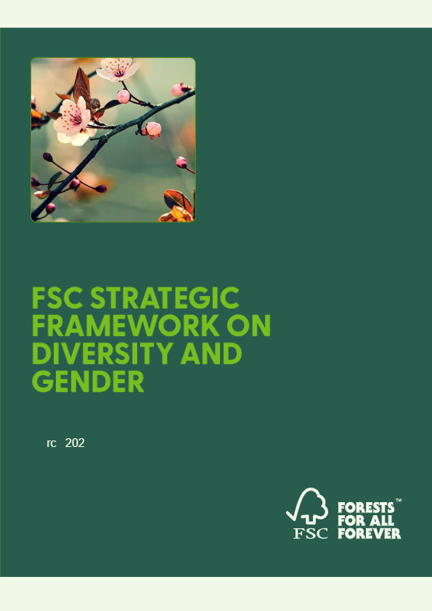
Diversity and Gender Framework (For Information)
2021 – 2026: 3 High-Level Goals
Co-create & Implement Forest Solutions*
Transform Markets
Catalyze Change
*Mainstreaming gender within the normative framework e.g., Principles & Criteria Revision.
Current Relevance for Chain of Custody?
See Clause 7.4, Annex D
In future?
Potential amendments Chain of Custody revision.
Sources:
FSC Strategic Framework on Diversity & Gender
C111 – Discrimination (Employment and Occupation) Convention, 1958
Notes:
3 high level goals to be achieved by 2026.
To advance diversity and gender within FSC, a roadmap has been developed through a Strategic Framework. To implement the Strategic Framework on Diversity and Gender 2021-2026, in 2023, FSC started mainstreaming gender and diversity within the organization.
By the end of 2026, work includes strengthening gender components in the normative framework, including the Principles and Criteria, improving gender capacity, and strengthening indicators.
Linked to the Strategy, FSC also have the Diversity and Gender Framework, which follows the same high-level goals, but looking at these from a diversity and gender lens.
Currently, it is good to keep in mind how this element is covered in CoC, under discrimination in Clause 7.4 (FSC-STD-40-004), and to bear in mind potential future changes to the normative frameworks to further incorporate the aim of mainstreaming gender.

Slide 7

Workers’ Rights in FSC
Principles and Criteria for Forest Stewardship Standard
(FSC-STD-01-001 )
FSC Certification and ILO Conventions Policy
(FSC-POL-30-401)
Policy for Association
(FSC-POL-01-004)
Guideline for Standard Developers on the Generic Criteria and Indicators based on ILO Core Convention Principles
(FSC-GUI-60-008)
Chain of Custody Standard
(FSC-STD-40-004)
Procedure on Equivalence Assessment of Verification Schemes against the FSC Core Labour Requirements
(PSU-PRO-10-003)
Directive on Chain of Custody Certification
(FSC-DIR-40-004)
FSC Directive on Chain of Custody Evaluations
(FSC-DIR-20-011)
Document Links
CLR Equivalence Assessment Procedure
Dec 2022
System-wide change
2014
2023
ILO Conventions in FSC Policy
Instructions on Evaluation of Contractors
FSC
Approved Scheme
2002
2021
FSC CLR in CoC
1994
2009
FSC Principles & Criteria
ILO & Policy for Association
Notes:
•So, what is the role of workers’ rights within FSC?
Well, FSC has a long history of commitment to compliance with the International Labour Organization’s labour conventions.
•This commitment has been referenced in the Principles and Criteria as far back as 1994, with implementation of these in FSC policy for over 20 years.
•A major milestone for FSC was in 2014 (on slide – ‘System wide change’), where the Board of Directors requested the FSC Secretariat develop a system wide solution for certificate holder compliance with the ILO’s fundamental rights. This set the scene for what then became the revised Chain of Custody Standard (Version 3-1), which came into effect in 2021.
•Since then, there have been subsequent updates relevant to core labour requirements, such as the equivalence assessments, and 2 important Advice Notes, which are covered later on in the presentation.
•The links have been provided on this slide, for future reference.

Slide 8

Policy for Association (PfA)
6 Unacceptable Activities including:
  Violation of workers’ rights and principles defined in the International Labour Organization (ILO) Declaration on Fundamental Principles and Rights at Work within forestry or forest products sector.
Applies to any ‘associated’:
Individual
Organization
Corporate group
If violation of PfA found, potential:
- disassociation; or
- association not granted
If FSC CLR are not met, any non-conformity is raised on the CoC standard requirements.
Notes:
As mentioned in the previous slide, workers’ rights are covered in the policy for association.
There have been some questions to FSC on how FSC CLR fits with the FSC policy for association or ‘PFA’. The PfA is an agreement that expresses the values shared by the organization. It agrees that the organization or associated organizations or persons will not permit any of the 6 unacceptable activities either inside or outside of their FSC-certified operations.
1 of these 6 unacceptable activities are ‘workers’ rights violations’
It is important to stress that although both Chain of Custody requirements and PfA cover workers’ rights, these are 2 separate documents, with differing scopes.
The CoC ceritification covers the organization and contractors in the activities in the scope of the certification, the PfA is further reaching to those not actually certificate holders but ‘associated’.
For more information, see the Policy for Association: link.

Slide 9

Definition of ‘Workers’
All employed persons, including public employees as well as ‘self-employed’ persons.
This includes part-time and seasonal employees, of all ranks and categories, including laborers, administrators, supervisors, executives, contractor employees as well as self-employed contractors and sub-contractors
  Sources:
  C155 - Occupational Health and Safety Convention, 1981 (see Article 3b))
  Annex E of FSC-STD-40-004 V3-1
Notes:
When there is a reference ‘workers’, it is important to understand what we mean in the context of CoC.
FSC defines them as:
All employed persons, including public employees as well as ‘self-employed’ persons.
This includes part-time and seasonal employees, of all ranks and categories, including laborers, administrators, supervisors, executives, contractor employees as well as self-employed contractors and sub-contractors
This means more than protecting only those who are direct employees of the certificate holders!
The definition is provided in Annex E of the CoC Standard.

Slide 10

CORE LABOUR REQUIREMENTS (CLR)
© FSC / Jjumba Martin

Slide 11
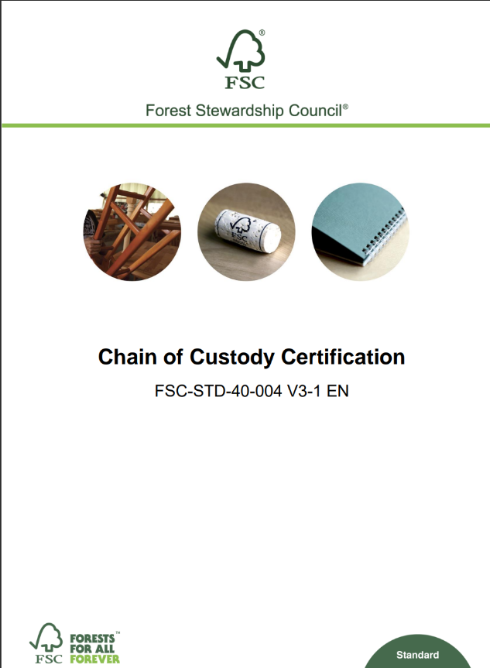
Definition of Core Labour Requirements (CLR)
International Labour Organization (ILO) generic criteria and indicators that are underlined in the FSC report covering fundamental principles and rights at work:
  freedom of association and the effective recognition of the right to collective bargaining;
  the elimination of all forms of forced or compulsory labour;
  the effective abolition of child labour; and
  the elimination of discrimination in respect of employment and occupation.
Source:
Annex E of FSC-40-004 V3-1 (Definition)
(FSC-GUI-60-008) (Report)
Notes:
What are the requirements?
Many of you will be familiar with them already, but to remind ourselves, these are based on these ILO fundamental principles and rights at work (at the time of publication 2021), and currently include 4 topics:
freedom of association and the effective recognition of the right to collective bargaining;
the elimination of all forms of forced or compulsory labour;
the effective abolition of child labour; and
the elimination of discrimination in respect of employment and occupation.
The link to the ILO will be covered in module 2, but generally speaking, each requirement has 2 underlying conventions which are the basis to each clause.
Be aware that the ILO Declaration now includes Health and Safety, however this update will be reflected in the revised standard, with the actualities to be determined during the revision process.

Slide 12
Relevant Standards for CLR
FSC-STD-40-004
Chain of Custody Certification
FSC-STD-20-011
  Chain of Custody Certification & Chain of Custody Evaluation
REQUIREMENTS FOR CERTIFICATION
EVALUATION OF REQUIREMENTS
Clause 1.3, Clause 1.5, Clause 1.6, Clause 1.11
CoC Management Systems
Section 7: FSC core labour requirements
Annex D: Self-Assessment
Section 11 :
Evaluation of FSC core labour requirements
Notes:
The FSC core labour requirements are set out in Standard 40-004 V3-1, with relevant clauses in Section 1, 7 and Annex D.
There is also the related Standard 20-011 (V4-2), which sets out how these requirements are to be evaluated by auditors; the 2 standards must be read in conjunction.
The following slides detail of the requirements and how these Standards relate to one another.
The colours used are to highlight these 2 elements, with green for CHs and yellow for CBs.

Slide 13
Section 7 Clauses
Clause 7.1
Due consideration to rights and obligation of national law
Clause 7.2
The organization shall not use child labour
Clause 7.3
The organization shall eliminate all forms of forced and compulsory labour
Clause 7.4
The organization shall ensure that there is no discrimination in employment and occupation
Clause 7.5
The organization shall respect freedom of association and the effective right to collective bargaining
Notes:
These are the main clauses for Section 7 – subclauses exist for each (see STD-40-004 V3-1).
Reminder: these are the main clauses when we say/reference ‘CLR’.
Each of these clauses have subclauses, that provide more detailed requirements, however the slide provides just the main clause wording.
Clause 7.1: this is an umbrella clause, reiterating that national law must complied with but also CLR must be conformed to in all circumstances and in all countries. Bearing in mind that not all countries have ratified the ILO conventions and, therefore, to conform to CLR, some places may have to use alternative mechanisms to meet these requirements.
Background for Speaker
Example – Freedom of Association
Certain countries restrict the choice of trade union, meaning workers do not have free choice, about freedom of association.
Organizations, therefore, can still conform to CLR by providing alternatives. In this case, organizations provide opportunities for workers to establish their own organization/committee at the level of the organization. This enables workers to use this alternative mechanism to exert their rights and protect their rights in relation to working conditions and employment terms.

Slide 14
Implementation of CLR
Develop your policy statement(s) that contain the core labour requirements
Implement your policies on the core labour requirements
Complete the self-assessment and submit it to the certification body
Certificate Holder
Auditor evaluates the self-assessment, and uses it to guide on-site audit and checks evidence
Auditor verifies that the policy statements are made available to stakeholders
Auditor verifies the policy statement(s) has been adopted and implemented
Certification Body
Notes:
This process flow shows how CLR is implemented, with the green boxes being actions for the certificate holder (CH), and the yellow boxes for the certification body who are evaluating the CH.
The main things to note are:
Policy statement
Implementation of CLR in policies (and where relevant, procedures (clause 1.1b) )
Fill in and submit the self-assessment
*all of these elements should be kept updated, with reference to any normative changes or organizational changes.
Making sure that the procedures are up-to-date.
Procedures are amended to normative changes.

Slide 15
Policy Statement – Requirements
Clause 1.5
The organization shall adopt and implement a policy statement, or statements, that encompass the FSC core labour requirements.
The policy statements shall be made available to stakeholders (i.e. affected and interested stakeholders) and to the organization’s certification body
FSC-STD-40-004
Adopt & Implement
Make Available
Affected & Interested Stakeholders
Certification Bodies
Example:
We support freedom of association and collective bargaining as part of our commitment to support the fair and equitable treatment of workers.
COMMUNICATE COMMITMENT TO CLR
Notes:
This is the organization’s commitment to CLR, provided in either a policy statement or potentially other statements and this is made available to affected and interested stakeholders including the CB. By having the statement(s), they are communicating their commitment to fulfilling the core labour requirements.
Who are affected and interested stakeholders?
Definitions are included in Annex E of 40-004.
Affected stakeholder: Any person, group of persons or entity that is or is likely to be subject to the effects of the activities of the organization. Examples include but are not restricted to workers, persons, groups of persons or entities located or working in the operations and sites of the organization.
Interested stakeholder: Any person, group of persons, or entity that has shown an interest, or is known to have an interest, in the activities of the organization

Slide 16
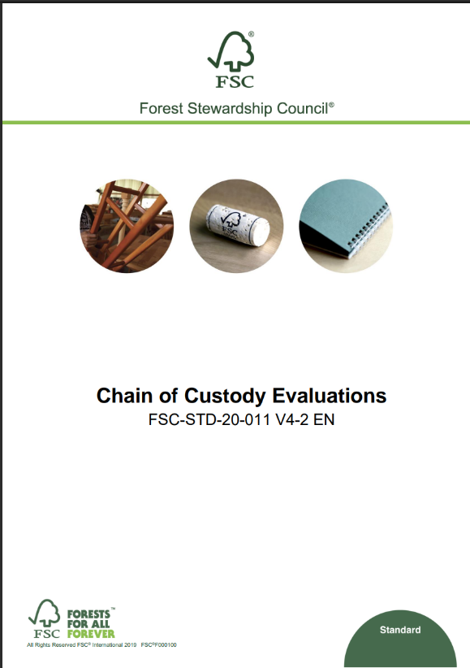
Policy Statement – Evaluation
FSC-STD-20-011
Clause 11.1
The certification body shall verify that the organization has adopted and implemented a policy statement, or statements, that encompass the FSC core labour requirements.
Clause 11.2
The certification body shall verify that the policy statements are made available to stakeholders.
Adopted & Implemented
Made Available
VERIFY COMMUNICATION OF CLR COMMITMENT
Notes:
Following on from the activities required by the certificate holder, the CB must then verify the policy statement/statements exist, include the CLR, and are made available. This does not necessarily mean being on their public website, however it does require them to be available for the CB to view.
There have been some questions to FSC about whether ‘available on request’ is sufficient. This will be further covered in ASI’s presentation, but ideally, policies that are affected and interested stakeholders are unaware of cannot be ‘requested’, therefore communicating commitments to CLR widely is recommended.

Slide 17
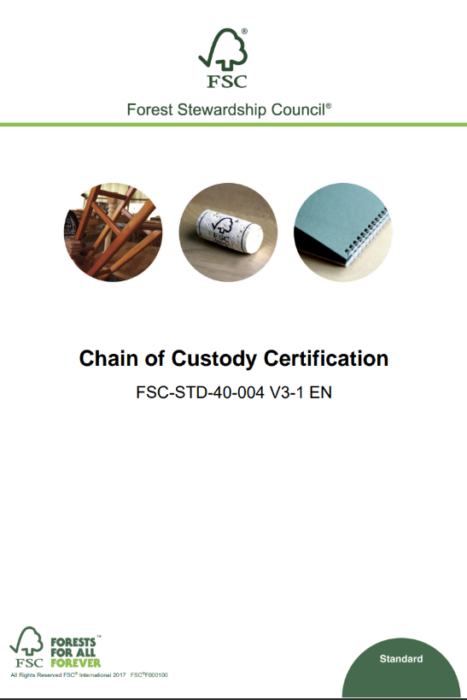
Self-Assessment (SA) - Requirements
FSC-STD-40-004
Clause 1.6
The organization shall maintain an up-to-date self-assessment in which it describes how the organization applies the FSC core labour requirements to its operations. The self-assessment shall be submitted to the organization’s certification body.
Annex D
(Normative Information & Self-Assessment Template)
Maintain
Keep Updated
Submit to certification body
DEMONSTRATE COMMITMENT TO CLR
Notes:
The self-assessment is a key document for CLR and includes information to demonstrate how the organization conforms to the requirements. Once filled in, it is submitted to the CB prior to audit; exact timings vary and are dependent on the CB’s requirements.
It is the responsibility of the CH to ensure the information provided is up-to-date.
A template and more information on the self-assessment are provided in Annex D of Standard 40-004.

Slide 18
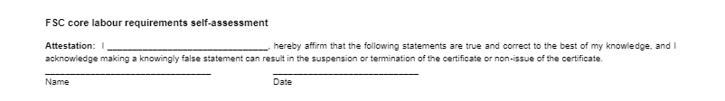
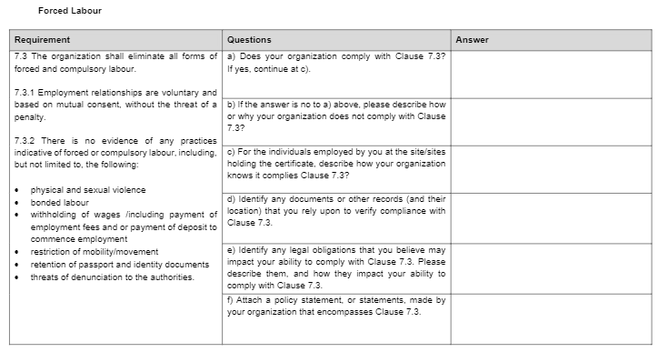
Self-Assessment Template (example)
Attestation
Detail on Conformity
FSC Network Partners have created tailored templates for some countries: FSC Connect
Notes:
This is an excerpt from Annex D showing parts of the template that you will be familiar with. This requires a responsible person at the organization to sign (by hand/digital/name) affirming the contents are true.
Each section of the template relates to a clause, with the same questions for each.
Some network partners have tailored the self-assessments for their country, to make it simpler for CHs in those countries to fill in (link provided on slide).

Slide 19
Self-Assessment (SA) - Evaluation
FSC-STD-20-011
Clause 11.3 The certification body shall design and implement a system for evaluating the relevance, effectiveness, and adequacy of the organization’s self-assessment and conformity to Section 7 of FSC-STD-40-004, according to the scope, scale, intensity and risk of the organization's operation. The certification body shall specify, justify and document in its system the means of verification of the self-assessments, including, but not limited to:
a) a mechanism for verifying self-assessments against available sources of information and applicable requirements;
b) identifying the legal requirements related to the FSC core labour Requirements and applicable to the organization/site.
c) corroborating evidence provided by the organization with independent sources when possible. (e.g. documentation, interviews etc.) as required according to Section 2.6 ‘Evaluation at the level of the operational site’.
d) determining the frequency and sampling requirements of future audits within the certification cycle for each organization based on the results of the previous audit related to the FSC core labour requirements and the self-assessment.
e) including auditors with specific competencies if needed.
Verify
Identify Applicable Legal Requirements
Corroborate
EVALUATE COMMITMENT TO CLR

Slide 20

SECTION
HEADER SLIDE
RAISING A CLR NONCONFORMITY
© FSC / Christian Irrgang

Slide 21
NCs: Simplified Process Flow
CB applies Section 11 of Evaluation of FSC Core Labour Requirements
Findings
Audit Report
Corrective Action Request (CAR)
Decision
Results of the evaluation of audit criteria
Conformity or nonconformity indicated
Systematic presentation of findings
Major or minor
timelines for conformance
Status (open or closed)
Description of the nonconformity
CB responsible for certification decision
Certification decisions are based on evaluation of conformity to each applicable requirement
(See Clause 4.1 of FSC-STD-20-011 V4-2)
Notes:
This is only a simplified process for raising a nonconformity on core labour requirements; the process flow provided is the basic one which would apply to any CoC requirements.
The CB is required to apply Section 11 of STD-20-011, and evaluate the audit criteria, deciding if there is conformity or non-conformity, with this being provided in the audit report. For issues found, a corrective action (CAR) should be provided, detailing the criticality (major/minor), timelines etc.
Decisions on whether to grant certification are based on conformity of each applicable requirement.
More information on grading is in FSC-STD-20-001.

Slide 22

EQUIVALENCE TO OTHER SCHEMES
© FSC Belgium / Bart Holvoet

Slide 23
CLR Equivalence Assessments
FSC Approved Scheme = SA8000
  Section 1
  Certificate Holder Requirements
  FSC approved verification as conformity to CLR
  Possible exemption from Clause 1.6 of STD-40-004 V3-1
  Records made available
  Update CB of any changes/updates to conformity with scheme
  Section 2
  Certification Body Requirements
  Possibly waive requirements in Clause 11.3 of STD-20-011 V4-2 if:
    FSC approved scheme & authenticity verified
  Document findings & conclusions in Evaluation Reports
  Record any changes of status of attestation of conformity
Source: FSC-ADVICE-40-004-24 and FSC-ADVICE-20-011-16
Notes:
In the 40-004 standard, a clause (1.11) was provided to give the option to demonstrate compliance to CLR through other certification schemes; understanding some organizations already have social compliance audits etc.
To assess these schemes, a process was created by the Policy & Performance Unit (P&P) at FSC International, and consulted on with stakeholders. This followed by a call for applications, where stakeholders were asked to provide suggestions on the schemes they would like to have assessed.
The outcome of the assessment was 1 scheme, SA8000, being assessed as equivalent and Advice Note 24 (ADVICE-40-004-24) is the outcome of this.
This means organizations who have valid SA8000 can show conformity with CLR by providing access to the reports etc. of their SA8000 audit.
The CB auditor would include this information in their evaluation report and ensure to verify the authenticity of the SA8000 certificate.
More information
SA8000 is a social audit certification from SAI (Social Accountability International), which is an NGO. This standard is based on ISO 17021.
The SA8000 certification focuses on organizations' management systems for workers’ rights and looks for continuous improvement; with regular audits to maintain certification.

Slide 24
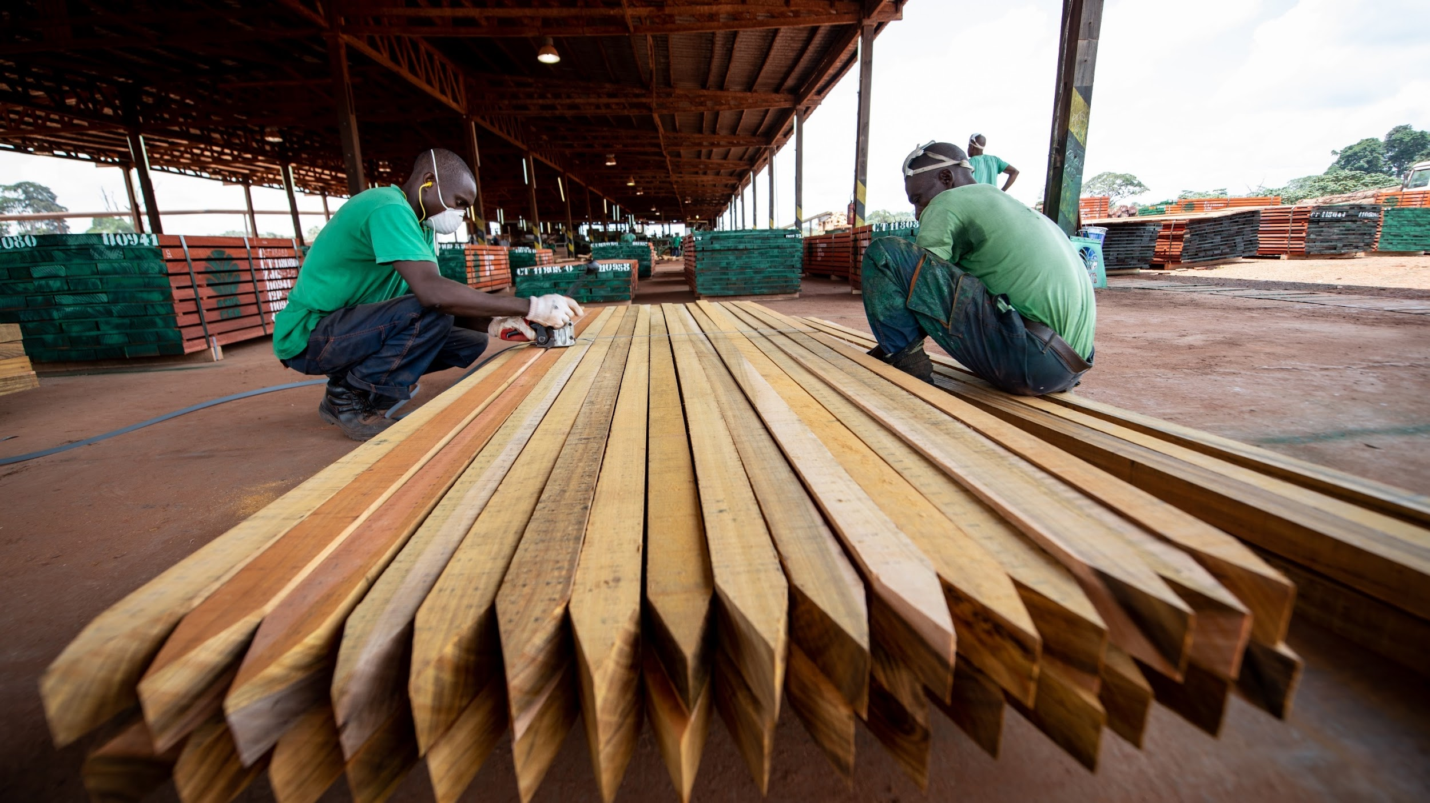
OUTSOURCING
© FSC Belgium / Bart Holvoet

Slide 25

CLR & Contractors
Outsourcer
13.1 The organization may outsource activities within the scope of its certificate to FSC-CoC-certified and/or non-FSC-CoC-certified contractors
FSC-STD-40-004
Outsourcer
CH
Outsourcer
How to apply CLR (Section 7 of STD-40-004 V3-1) for non-FSC-certified contractors with Outsourcing Agreements (Section 13)?
Outsourcer
Draft 🡪 Consultation 🡪 FSC-ADVICE-40-004-23 FSC- ADVICE-20-011-16
Notes:
In the scope of certification, outsourcing agreements may be used to outsource activities. This means those workers in these activities are included in the evaluation (section 13).
So how should this be dealt with?
Stakeholders (certification bodies) requested that FSC provide normative reference, so that it was clear that this needed to be evaluated and how this was done, was applied the same across the board. This initial discussion in 2022 was the starting point for creating Advice Note 23 (40-004-23)
The first version of the Advice Note 23 was provided last year and made effective from July 1st, 2023. Since its introduction, FSC has received various concerns from stakeholders, and requests for change. Therefore, a new version was published in August 2024, aiming to address these concerns and provide clarification.

Slide 26
CLR & Contractors
(ADVICE-40-004-23 V2-0)
Organization
Certification Body
Outsourcing agreement terms include contractor commitment to CLR
(or separate document specifying commitment)
Checks of outsourcing agreement, policy commitment and self-assessment, as part of the CB checks on the organization.
See section 11 of STD-20-011::
Clause 11.1 and 11.2: policy statement
Clause 11.3a): self-assessment
Self-assessment includes contractors
(or provided separately by the contractor)
Notes:
In the scope of certification, outsourcing agreements may be used to outsource activities. This means those workers in these activities are included in the evaluation (section 13).
So how should this be dealt with?
Stakeholders (certification bodies) requested that FSC provide normative reference, so that it was clear that this needed to be evaluated and how this was done, was applied the same across the board. This initial discussion in 2022 was the starting point for creating Advice Note 23 (40-004-23)
The first version of the Advice Note 23 was provided last year and made effective from July 1st, 2023. Since its introduction, FSC has received various concerns from stakeholders, and requests for change. Therefore, a new version was published in August 2024 (Version 2), aiming to address these concerns and provide clarification.

Slide 27
CLR & Contractors (1 of 2)
(ADVICE-40-004-23 V2-0 and ADVICE-20-011-16 V2-0)
Organization
Certification Body
Audit evidence of contractor (1st-/2nd-/3rd- Party) made available to certification body for its risk assessment. *
Risk Assessment of Contractors (non-FSC)
Previous FSC evaluation | CLR NCs since last surveillance audit | High
 | Substantiated complaints since last FSC evaluation | High
 | No NCs or complaints | Low
No previous FSC evaluation | 1st-/2nd-/3rd-party audit meeting all: 1) demonstrated CLR conformance, 2) conducted ‘annually’ 3) Records available, 4) Including worker interviews | Low
No previous FSC eval./audit | Other verifiable aspects? | High/ Low
*Only applicable if the contractor has not been audited before, and has no previous evaluation for FSC
Notes:
Going further than only the commitment and description on how they conform to CLR, there is an additional element.
The CB is responsible for assessing the outsourcing agreement of the contractor as high or low. This looks at previous evaluation as part of the FSC audit process, complaints, and other audits. To properly assess this, the organization, if this applies, must provide additional information to the CB e.g. audit evidence and reports.
The table provides the different assessments low, high, where automatic high risk includes those with previous NCs or complaints.

Slide 28

CLR & Contractors (2 of 2)
(ADVICE-40-004-23 V2-0 and ADVICE-20-011-16 V2-0)
Certification Body
High
Low
On-site audit including interview with personnel and site observations.
Sampling:
as per clause 9.6 of FSC-STD-20-011
Documentation review (outsourcing agreement, self-assessment), checking for any changes.
Sampling:
as per clause 9.6 of FSC-STD-20-011
Notes:
If the outsourcing agreement is considered high risk, an onsite evaluation is required however sampling can apply as per FSC-STD-20-011, Clause 9.6.
If the outsourcing agreement is considered low risk, rather than an audit, the CB is only required to check documentation and ensure any changes are clearly indicated. This also can apply sampling as per FSC-STD-20-011, Clause 9.6.

Slide 29

Thank you

